Slide 1
Unethical communication
Communication used to undermine relationships or encourage social immorality is unethical communication

Slide 2
Types of unethical communication
Plagiarizing
Omitting essential information
Selective misquoting
Misrepresenting numbers
Distorting visuals
Failing to respect privacy or information security needs

Slide 3

1. Plagiarizing
Plagiarism is presenting someone else’s words or other creative product as your own. Plagiarism can be illegal if it violates a copyright.
For example: 1. Using someone’s quotes in your presentation without mentioning their name.
2. copying someone’s code without their concern.

Slide 4
2. Omitting essential information
Your audience must have all the information necessary to make an intelligent objective decision.
For example: every detailed information of the product you are delivering must be provided by you.

Slide 5

3. Selective misquoting
Distorting or hiding the true intent of someone else’s words is unethical.
For example: you are providing less information of the project assigned by the CEO of your company to the employees

Slide 6
4. Misrepresenting numbers
Statistics and other data can be unethically manipulated by increasing or decreasing numbers, exaggerating, altering statistics, or omitting numeric data.
For example: exaggerating the sales of your company.

Slide 7
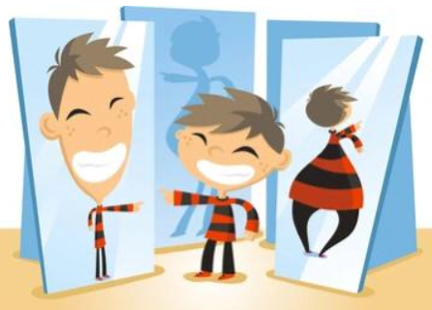
5. Distorting visuals
Images can be manipulated in unethical ways, such as altering photos to deceive audiences or changing the scale of graphs and charts to exaggerate or conceal differences.
For example: displaying the unethical pictures of your competitor company.

Slide 8

6. Failing to respect privacy or information security needs
Failing to respect the privacy of others or failing to adequately protect information entrusted to your care can also be considered unethical and is sometimes illegal.
For example: 1. revealing the secret of your colleague.
2. revealing the deal of your competitor company.

